Slide 1

18F Wireframes
Created By Adam D’Angelo
Updated By DevTech team

Slide 2
Version History
# | Date | Comments
1.0 | 6/17/2015 | Initial draft of wireframes
1.1 | 6/18/2015 | Updated with logo, color scheme, icons available for use
1.2 | 6/19/2015 | Updated per 6/19 5:00 PM demo

Slide 3

Shows top ten recent drug recalls for the month
Drug Recall Information Center
Enter the name a drug…
Search
Default Filters:
- 1 month
- Ongoing
- All
User can update filters to filter recall list
Recent drug recalls
Filter:
Classification Product Name Recall Date
Recall In Last:
Class 1 Drug #1 5/29/15
O 1 month
O 6 months
O All
Class 3 Drug #2 5/29/15
Status:
Class 2 Drug #3 5/29/15
O Ongoing
O Completed
O Terminated
O All
Product name = product name or 1st 20 char of Product Description if name is not available
Classification:
O Class 1
O Class 2
O Class 3
O All
Pagination
Developed by
Notes:
Homepage

Slide 4
Drug Recall Information Center
Displays drug recalls based on the user entered key word search. recent drug recalls for the month.
Enter the name a drug…
Search
Recent drug recalls
Filter:
Classification Product Name Recall Date
Recall In Last:
Class 1 Drug #1 5/29/15
O 1 month
O 6 months
O All
Class 3 Drug #2 5/29/15
User can update filters to filter searched results.
Provide legend on classification.
Status:
Class 2 Drug #3 5/29/15
O Ongoing
O Completed
O Terminated
O All
Classification:
O Class 1
O Class 2
O Class 3
O All
Pagination
Developed by
Notes:
Homepage

Slide 5
Drug Recall Information Center
Drug #1 Recall Details
Displays additional information on the drug recall user has selected to view in detail.
<Image of drug here from NiH>
Recall Date
Status
Product Name
Product Type
Manufacturer (recalling firm)
Distribution Pattern
Low
Provide users ability to go back home or to the search results (if drilled down from user search)
Product Description:
Reason for Recall
Developed by
Back to search results
Notes:
Homepage

Slide 6
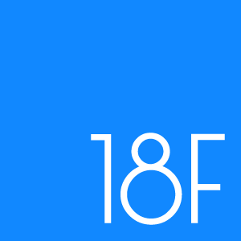
Logos:
Background and Fill Colors:
Body Text – Arial/Sans Serif, 12 pt
Form Fields or Buttons – Arial 12pt Bold
Heading – Arial/Sans Serif Bold 16 pt
Font:
Accent Colors:
Use red sparingly, if at all.
18F Logo Color:
We may want to use their instead of our, or add it in in places.

Slide 7








Icons

